Slide 1
Adult educator of teaching of digital learning tools and technology
The roles and responsibilities:
Planning, preparing and delivering lessons to all students in the class;
Develop, update, and improve course materials as appropriate;
Setting assessments and overseeing examinations
Create a stimulating learning environment

Slide 2
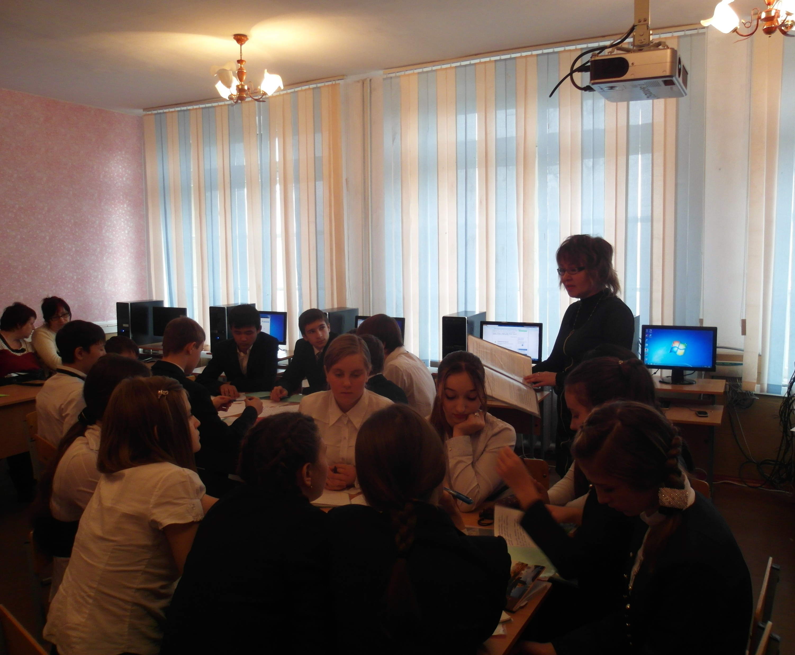
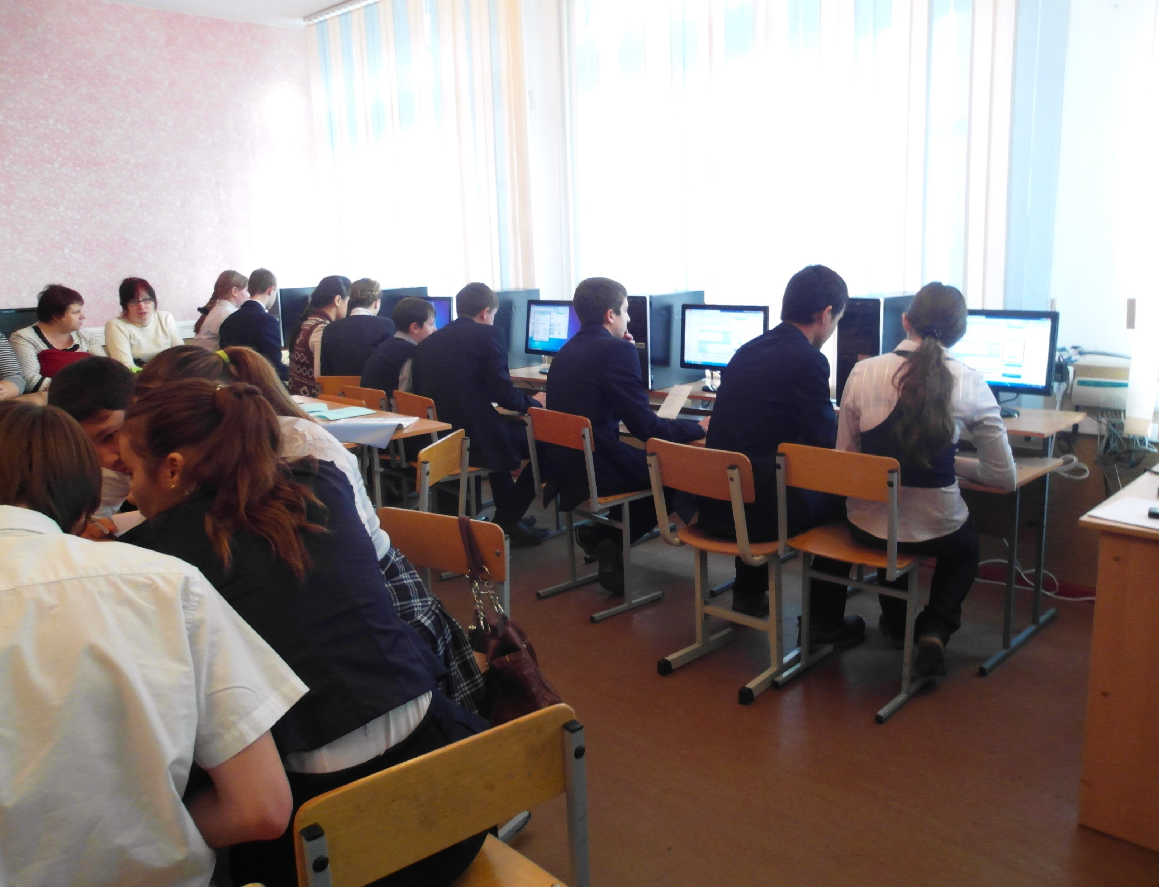
Time management skill
it allows you to efficiently and productively complete the activities and tasks you need to in the appropriate amount of time.
Digital literacy skill
using technology such as computers, smartphones, laptops, iPads, Chromebooks, or desktops.
Also, it’s essential for educator to available to interpret and analyze vast amounts of data effectively

Slide 3
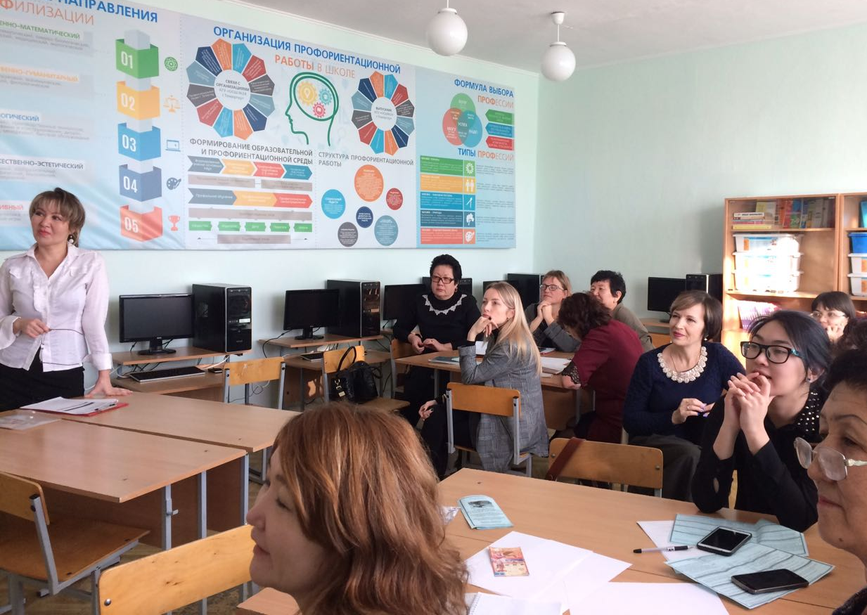
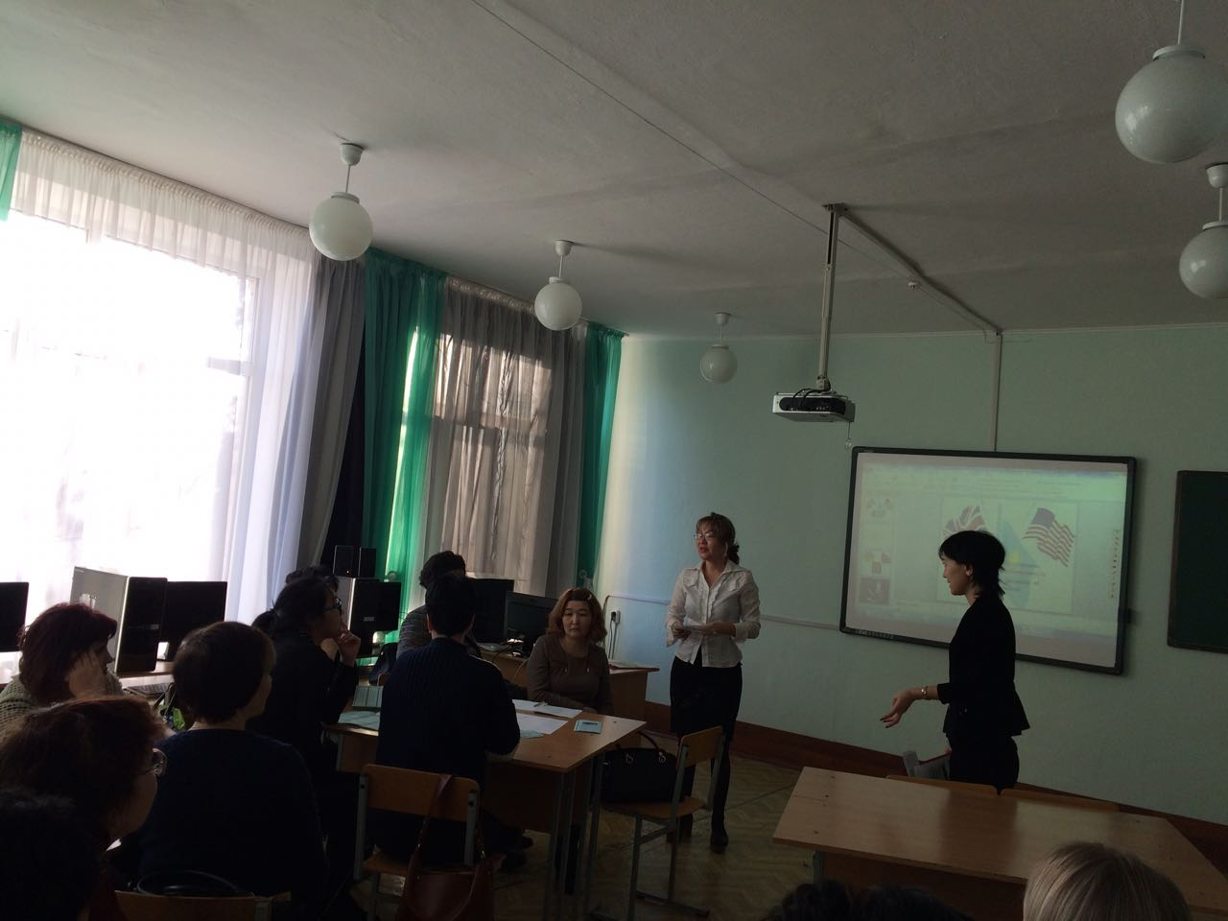
Organization
Teacher can often be responsible for upwards of 30 students at a time. A well-organized classroom can help ensure that students remain focused, have their supplies, and know where to turn in assignments and what they're learning about in class.
Communication
Teacher can use their communication while instructing, assigning homework, giving feedback and disciplining students. Strong communication skills can also help when having conferences with administrators too.
Online research skill
The ability to search for, locate, extract, organize, evaluate and use or present information that is relevant to a particular topic.

Slide 4
Advance Presentation skills
ECDL Advanced
ICDL Professional modules
It needed to plan and create more effective presentations, manage and protect presentations, as well as the technical considerations of giving presentations.
Java Script programming
JavaScript Programming
Full Online Course
To learning JavaScript may provide additional flexibility when developing applications. This technology also helps web developers create interactive content. Through JavaScript use, developers can introduce animations, scrolling effects, sliders, and other tools that boost user engagement and satisfaction.

Slide 5
The advent of the 4th industrial revolution
It will promote Virtual classrooms and Artificial intelligence
The role of AI:
The opportunity of generating advanced lectures and information visualization can be one of the most advanced examples of artificial intelligence in education.
Learning can be tailored and adapted to each student’s goals and abilities through personalized programs.
It has helped students and teachers with helpful feedback through its programs.
Make the class exciting and create inclusive learning environments

